Slide 1
Embedded Programming Guide
Andrew Hellrigel – Nov. 11 2021

Slide 2
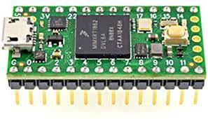
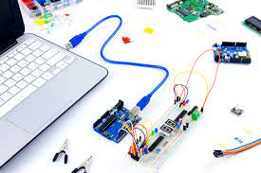
What is embedded programming?
Programming for microcontrollers
Microcontrollers are small devices capable of performing specific instructions which are generally used to interface with other devices
We use C++ as our embedded programming language
The most common microcontroller we use is the Teensy brand microcontroller

Slide 3
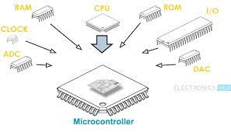
Microcontrollers
Microcontrollers have a CPU, RAM, ROM, I/O, Clock, ADC, and DAC
There is no operating system (OS) so it is not a computer

Slide 4
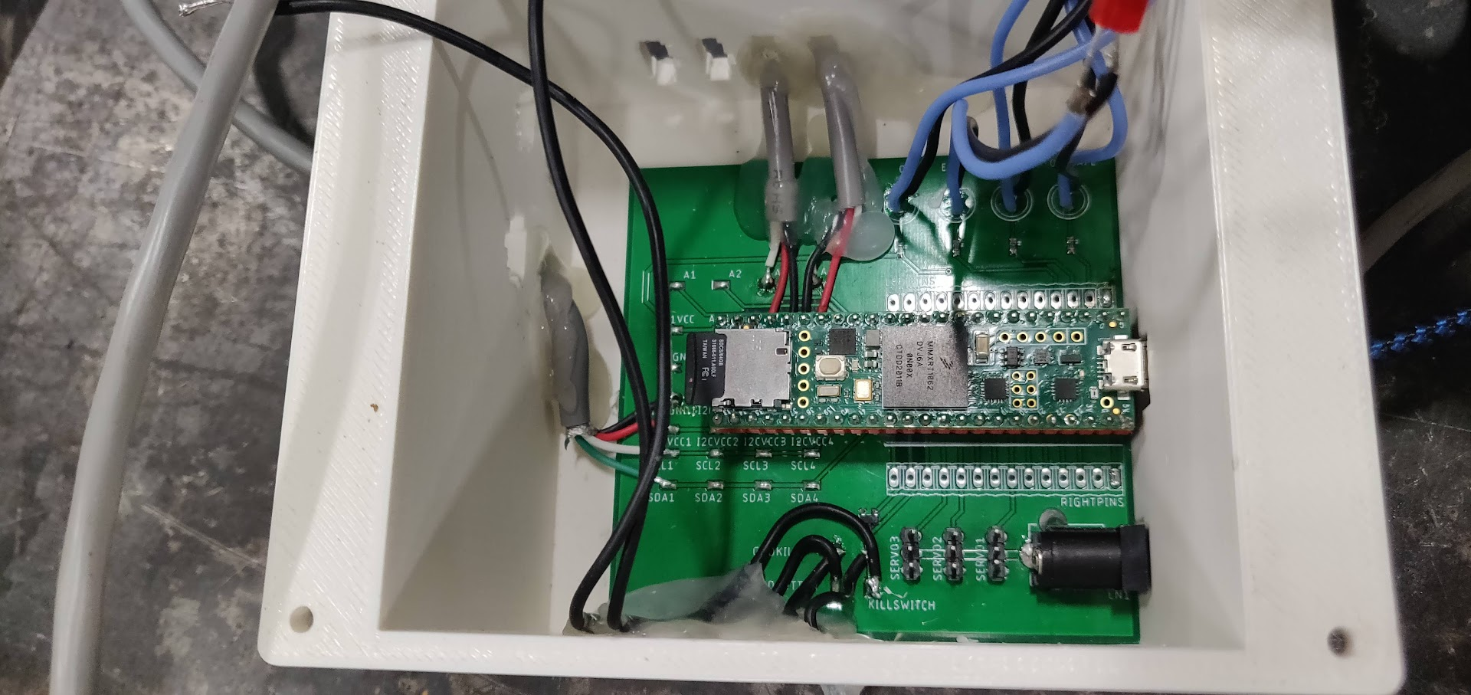
How does GTOR use Microcontroller
Microcontrollers serve as the “brain” for most of our designs and we use software to interface them with the DAATA application so that we can collect data from them

Slide 5
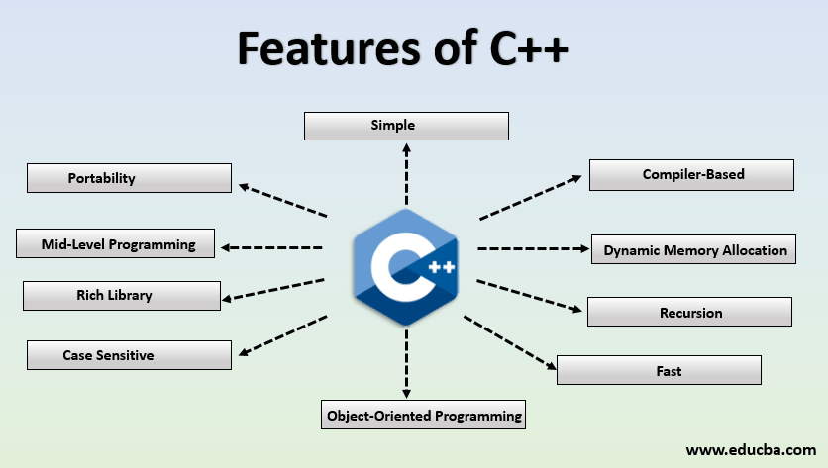
What is c++
C-plus-plus

Slide 6
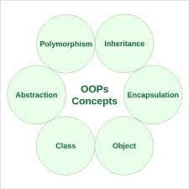
What is C++
High enough level to support object-oriented programming (OOP) style
Low enough level to be fast and supports microcontroller implementation
OOP concepts
Classes and Objects
Encapsulation
Abstraction
Inheritance and Polymorphism

Slide 7
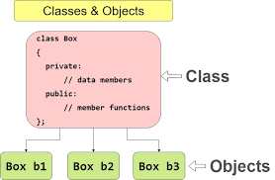
OOP – Classes and objects
A class is defined by a name and contains member variables and member functions
An object is a specific instance of a specific class

Slide 8
OOP - Encapsulation
Everything related to a certain object should be contained within that object’s class
Example: A speed sensor
Member variable –_speed
Member variable – _pin
Member function – get_speed()

Slide 9
OOP - Abstraction
The idea behind abstraction is that a class can abstract lower level pieces of code that a user doesn’t need to know
Example:
A speed sensor generates a pulse train and the microcontroller uses interrupts and timers to measure the delay between pulses to calculate the speed
A user doesn’t need to know how interrupts work or even how the speed sensor works, they can just create a SpeedSensor object, tell the microcontroller the pin that it is on, and call get_speed()

Slide 10
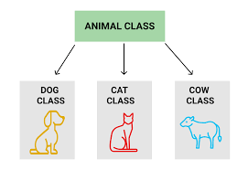
OOP – inheritance and polymorphism
Classes can inherit from other classes
They will inherit the member variables and member functions from the base class
Animal class
make_sound()
Dog class
Dog rufus;
rufus.make_sound();
>> “woof!”
Cat class
Cat leyla;
leyla.make_sound();
>> “meow”

Slide 11
OOP – Inheritance and polymorphism
Example – Analog Sensor
Analog sensor is the base class, since all analog sensors just read a voltage, however that voltage means different things for different sensors
LDS sensors have voltage -> linear position
Potentiometers have voltage -> rotational position
Load cells have voltage -> force
The underlying code is the same to read the voltage so they all inherit from analog sensor, but the conversion from voltage to a meaningful value is different for each class

Slide 12
C++ Tutorial
There are many C++ tutorials out there that will explain it way better than I can. To really be able to develop C++ and contribute to the team libraries, it will helpful to know most of what is contained in one of the below tutorials (or any other C++ tutorial online), but if you just want to be able to write a program to read data using sensor libraries we’ve already developed, the rest of this presentation should be sufficient.
C++ tutorial series (10 hours – individual videos)
https://www.youtube.com/watch?v=jcYaWFhV8oY&list=PL_c9BZzLwBRJVJsIfe97ey45V4LP_HXiG&index=2
C++ tutorial series (4 hours)
https://www.youtube.com/watch?v=vLnPwxZdW4Y

Slide 13
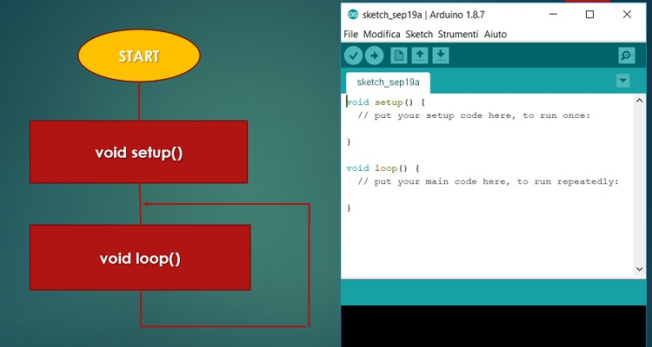
Structure of embedded code (for Arduino)
3 main sections – Start, Setup, and Loop

Slide 14
Start
All the code before Setup
File inclusions
Include all the libraries that you want to use in your code
Pin definitions and constants
Define any constants and pins to make code more readable
Object and variable creation
Create all of the objects you want to use in your code
Create any global variables needed throughout the code

Slide 15
Setup
This section of the code occurs once
Set up the hardware
Specify pin modes
Set up specific sensors
Initialize any communication protocols being used

Slide 16
Loop
This section of the code runs repeatedly
Collect data
Update sensor objects to read data from them
Control objects
Use functions to control different objects (i.e. tell a servo to go to a specific position or tell LED to turn on/off)
Communicate
Read/write data to different devices you are communicating with

Slide 17
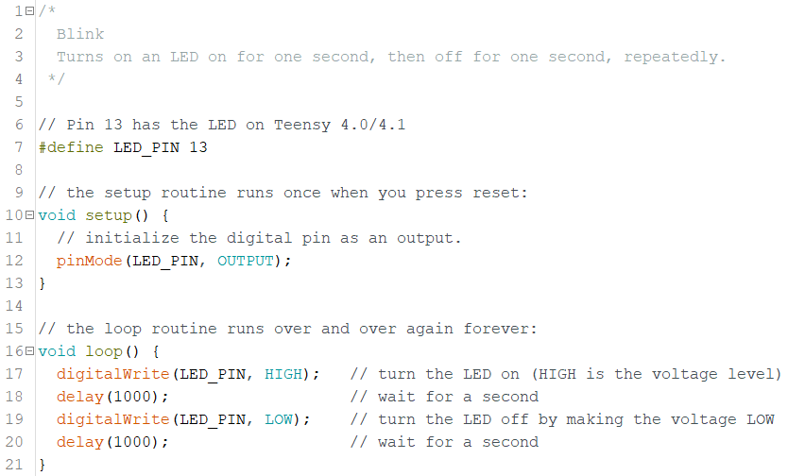
Case study: Arduino blink program

Slide 18
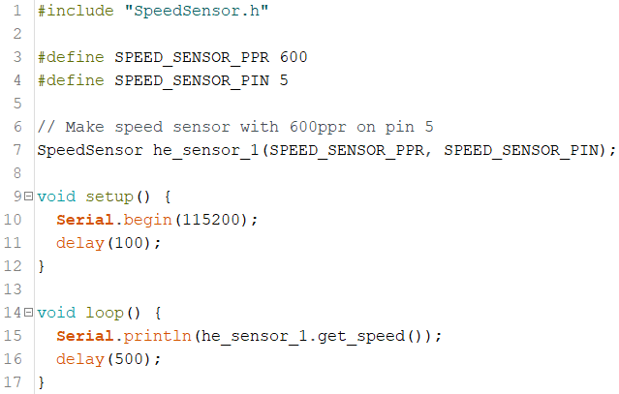
Case study: Read speed sensor

Slide 19
Combine previous code?
What if we wanted to blink an LED and read a speed sensor?
Is there any problems with combining the two sets of previous code?

Slide 20
Pseudo-threading
Can implement previous code using pseudo-threading
Allows executing certain sections of code based on timers, this way, a section of code can’t block another section of code from running due to a delay()

Slide 21
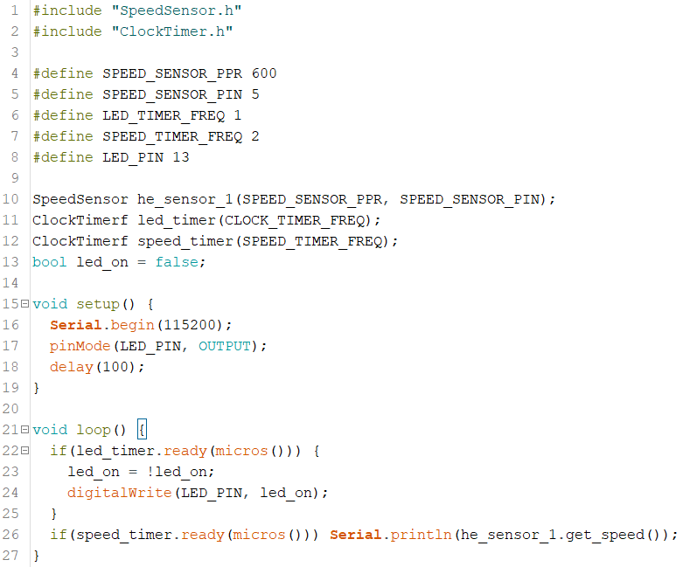
CASE Study: Read speed sensor and blink led

Slide 22
Putting it all together Case study: aux daq code
Goals
Read 4 LDS sensors, 2 speed sensors, and 1 IMU
Blink an LED so that we know code is working
Send data using communication utility so that DAATA can read it
Write data to SD card as backup
Communicate over Serial with computer if plugged in

Slide 23
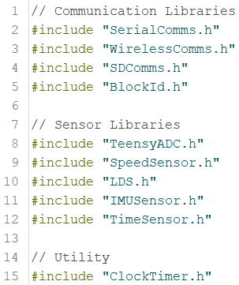
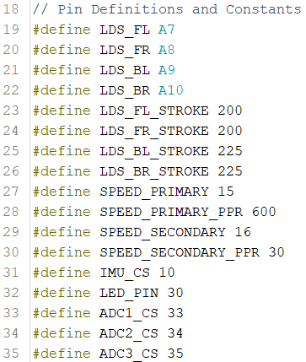
Aux daq: Start – file inclusion and pin definitions

Slide 24
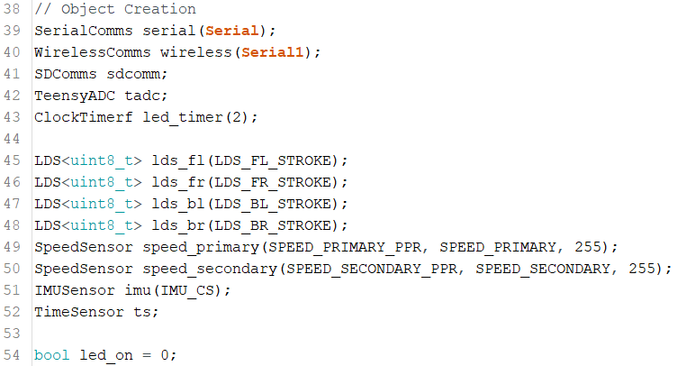
Aux daq: start – object creation

Slide 25
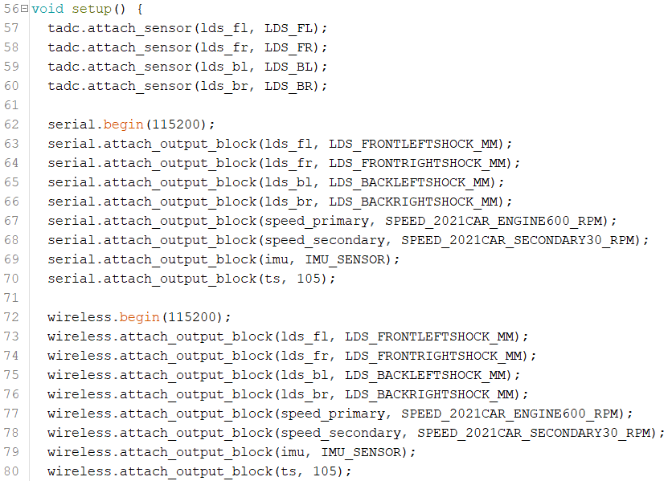
Aux daq: setup

Slide 26
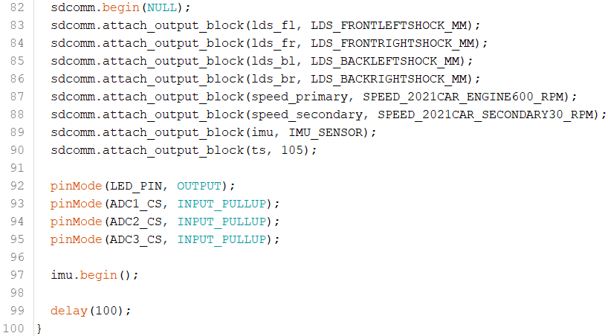
Aux daq: setup

Slide 27
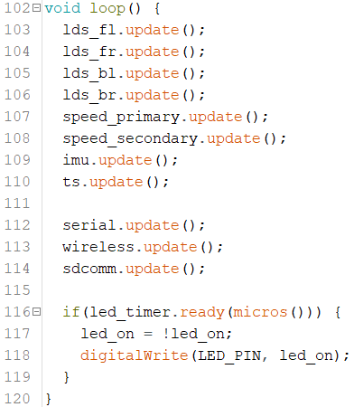
Aux daq: Loop

